Slide 1
A Tale of Two Institutions
Changing the Culture of Assessment

Slide 2
Actionable Steps
Evaluate current culture
Identify priorities to fill gaps
Create systems to support

Slide 3
Self-Determination Theory of Motivation
Autonomy
Competence
Relatedness

Slide 4
Establishing a Culture of Assessment (AACU 2009)
common use of assessment-related terms,
faculty ownership of assessment programs,
ongoing professional development,
administrative encouragement of assessment,
practical assessment plans,

Slide 5
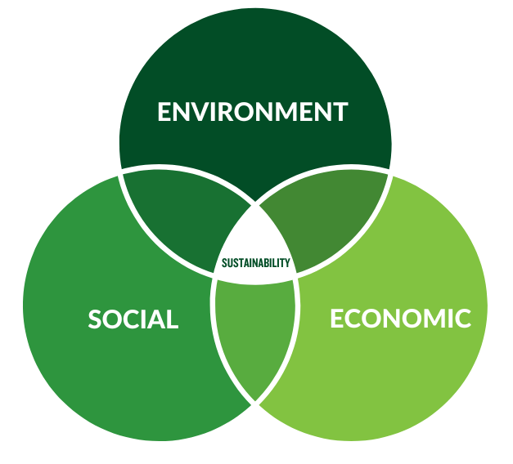
Sustainable Assessment

Slide 6
Takeaways
What are 1-2 interesting or promising ideas or techniques from this session?
What are some possible applications of those ideas/techniques to my work?

Slide 7
Contact Information
Dr. Jessica Stowell
Director of Institutional Effectiveness and Quality Improvement
Radford University
Jstowell1@radford.edu

